Slide 1
Project Name
Members name

Slide 2
Problem Description
Automated Essay Grading with feedback

Slide 3
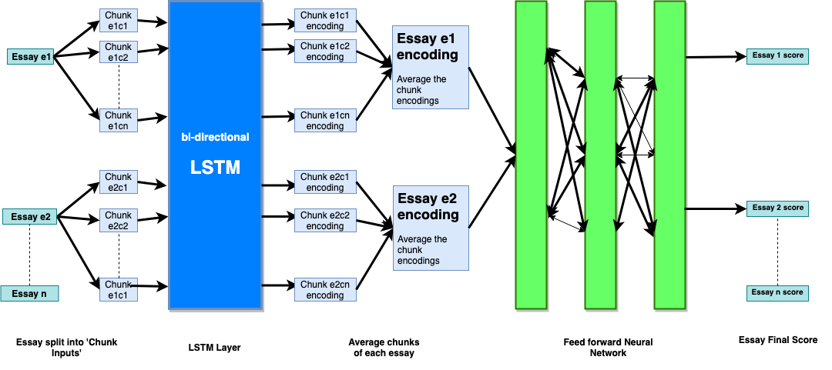
Our model

Slide 4
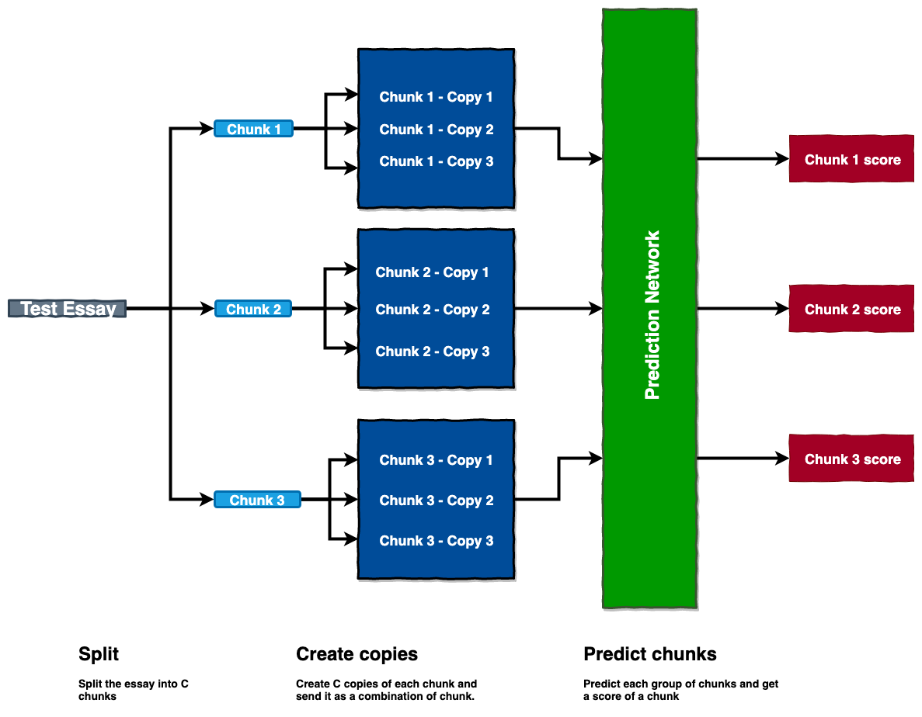
Chunk Prediction

Slide 5
Results
Word embedding | LSTM | GRU | RNN
Glove vectors | 0.1639 | 0.17119 | 0.1839
Word2vec

Slide 7
Related Work
https://web.stanford.edu/class/archive/cs/cs224n/cs224n.1174/reports/2731315.pdf
http://web.stanford.edu/class/cs224n/reports/custom/15722887.pdf
Hello
Hello

